Slide 1
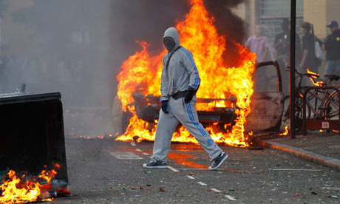
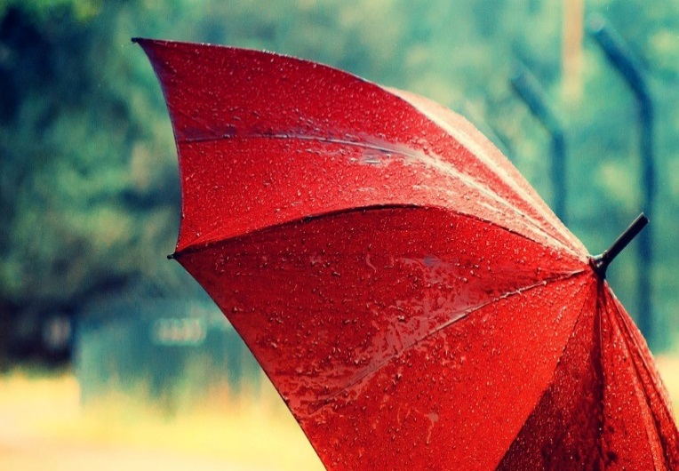
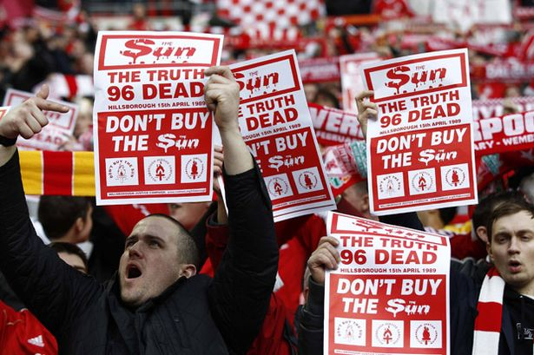
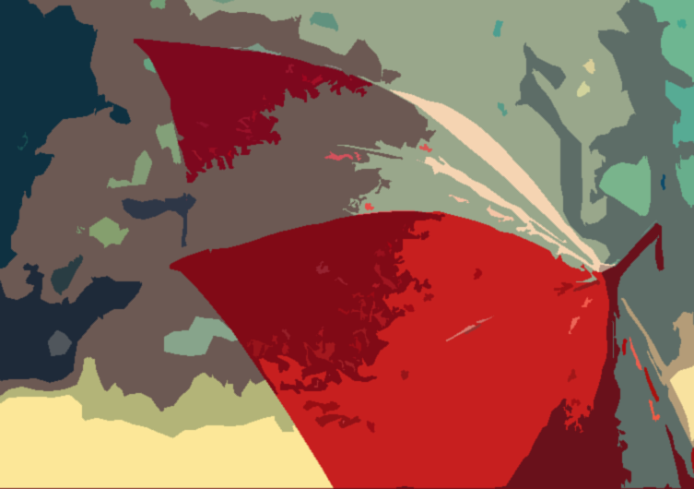
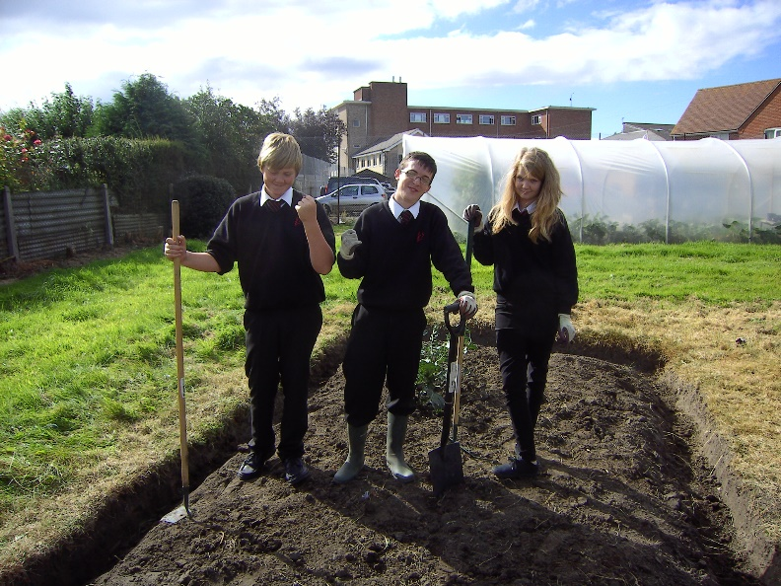
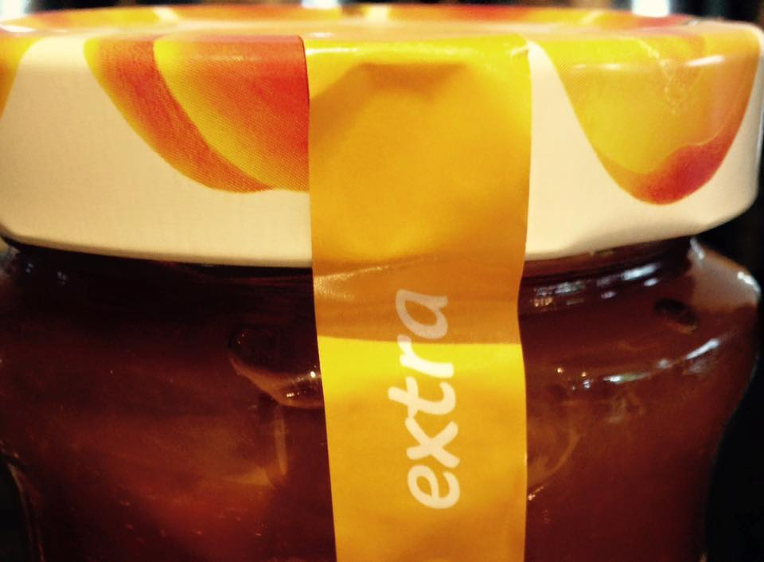
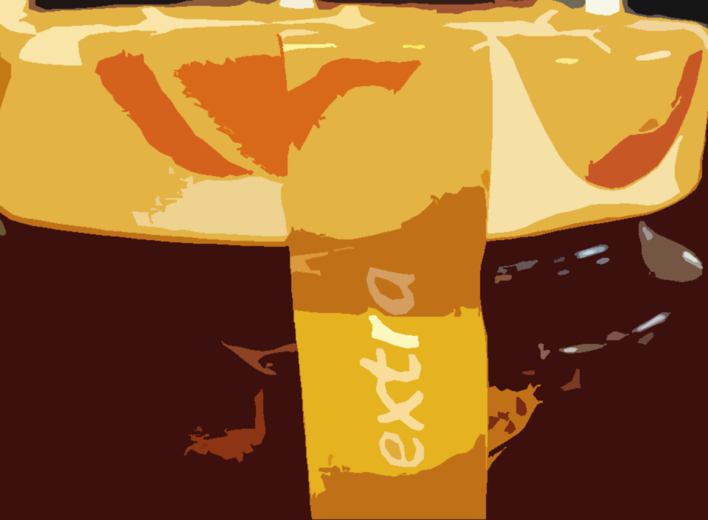
Alex Damon
Colour Film Mood board
When thinking about the colour red, I think of anger. These Liverpool fans show anger as they protest against the Hillsborough inquest. Anger is a red connotation.
When I think about the colour red in my mind apart from anger, I think about fire and violence. Fire and violence are red connotations. Here is an example during the 2011 London riots. Smoke and police sirens are examples of what could be smells and sounds.
When I did a course called CoPE, we did a gardening challenge and this picture went out to prove enthusiasm. Enthusiasm is a orange connotation.
Here is a picture of the end of a red colouring pencil, and it will be included in my film to portray the colour red.
Here is the lid of an apricot jam lid and it is most likely picture to be used in my film to portray the colour orange.

Slide 2
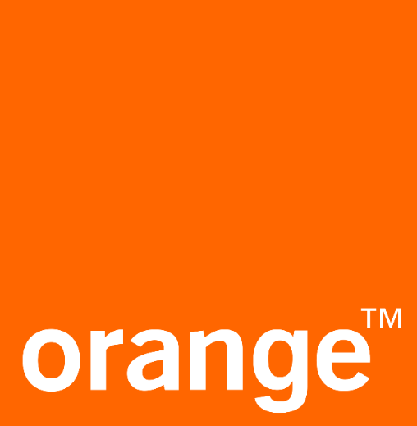
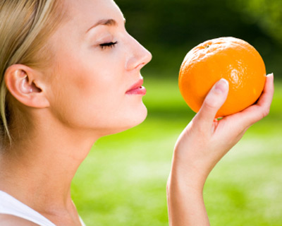
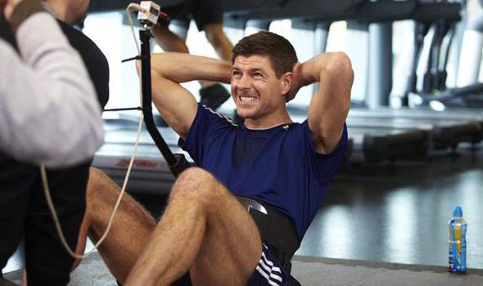
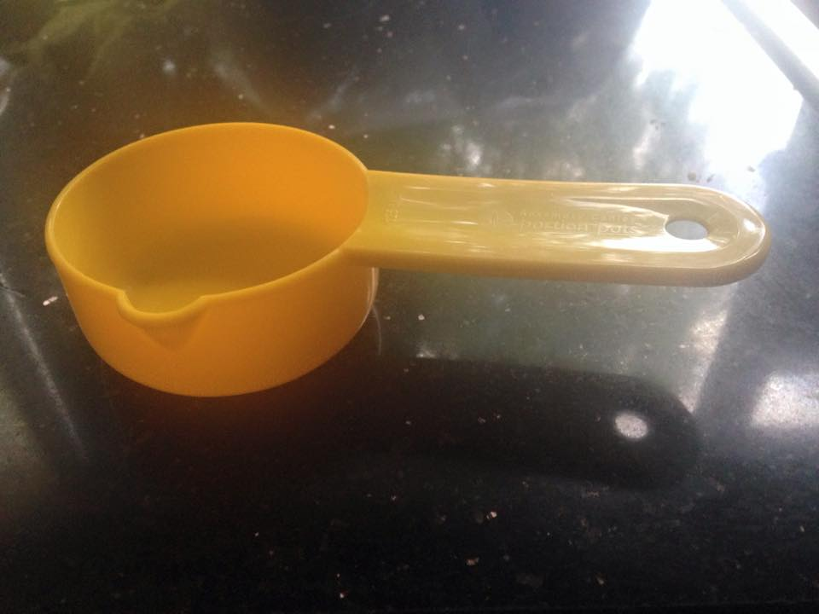
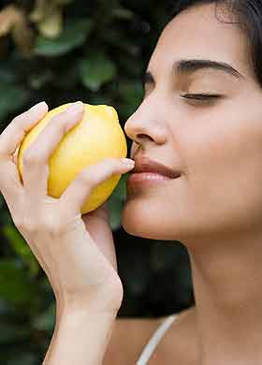
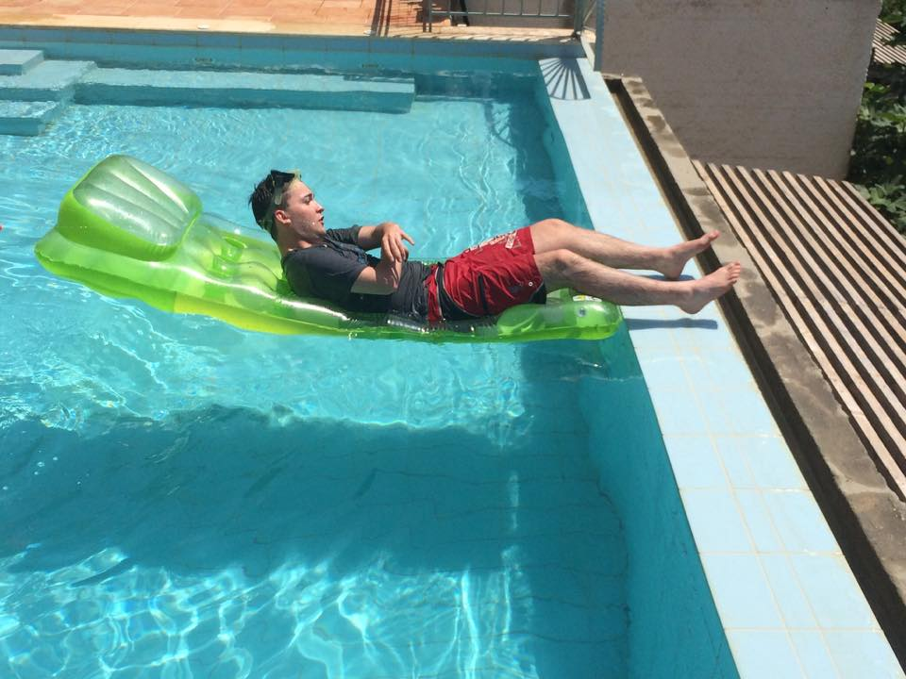
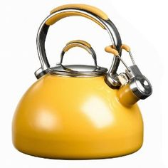
This is Steven Gerrard he may be 35 but this is him showing he has still got loads of energy as he trains for the season ahead. Energy is an orange connotation.
My little yellow saucepan will be the item to be used in the film when I show the audience what item I use to portray the colour yellow.
When I think about what orange would smell like, I think about the strong sweet smell of oranges. I may include it in my film to portray the colour orange.
Smelling lemons
Get picture of me lying on the lalio
Here is one of the many hazard warnings to look out for and also the word hazard is an yellow connotation.
When I think about the colour yellow in my mind apart from energy and hazard, I think about sunshine. Here is an example as I relax on holiday. Sunshine is a yellow connotations.
Just like oranges, when I think about the smells of yellow, lemons pop in mind due to the strong sweetness.

Slide 3
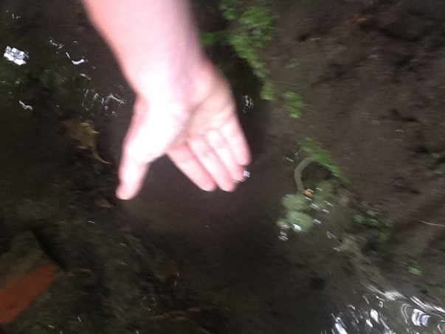
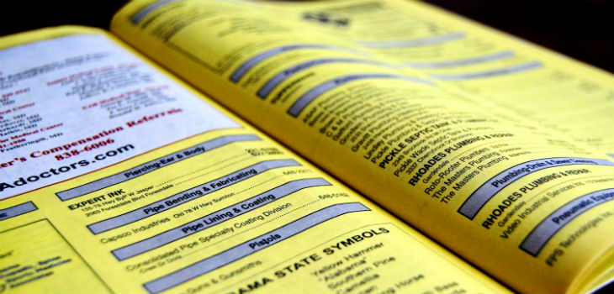
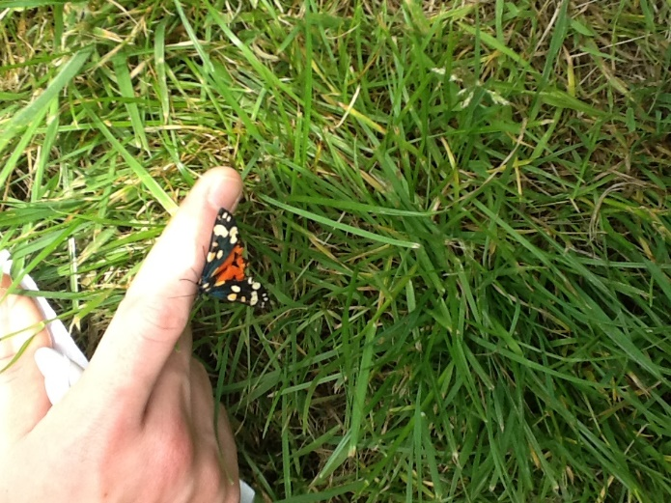
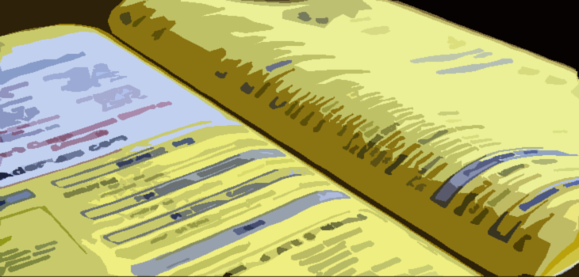
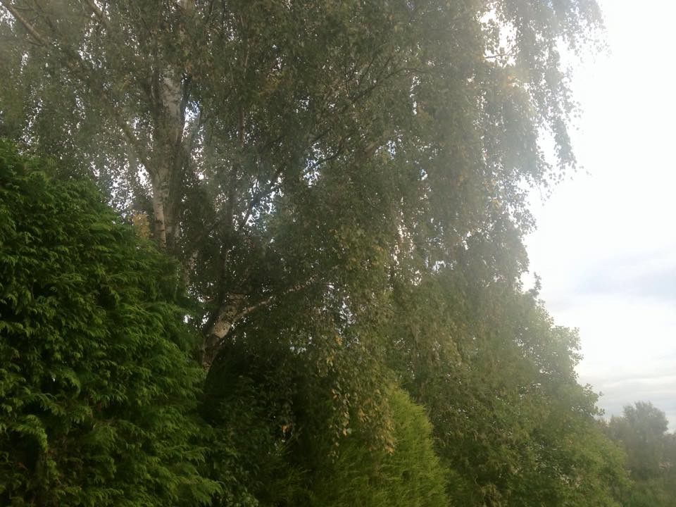
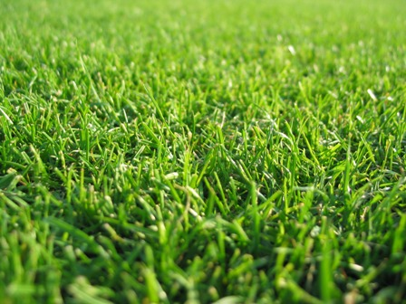
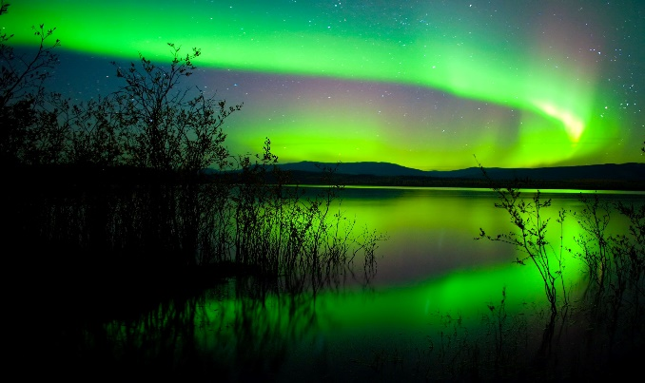
When I first thought about yellow, the yellow pages first came into mind, as this was my first thought I had to put it in my mood board.
The inspiration from this was to symbolism a close connection to the environment. Environment is a green connotation.
Healthy is a green connotation, also with this picture smells is proved by the wonderful fresh smell of the outside environment.
The inspiration from this was to symbolism a character having a close connection to the elements of unchanging nature. Unchanging nature is a green connotation.
Picture of woodland trees
Champange bottle cropped
When thinking about the colour green, I think of trees and it’s beautiful affections. I will be using this in the film to symbolise the colour green. Also with this picture sounds is proved by the sounds of whistling trees.
When I saw this I had to take a picture of the freshly cut grass because the smell of it is so nice to sniff and it gives me an indication that it is going to be a good day.
This is some northern lights in Lapland, I put it on my moodboard because it brings back great family memories in Lapland and also it was a wonderful view to look at.

Slide 4
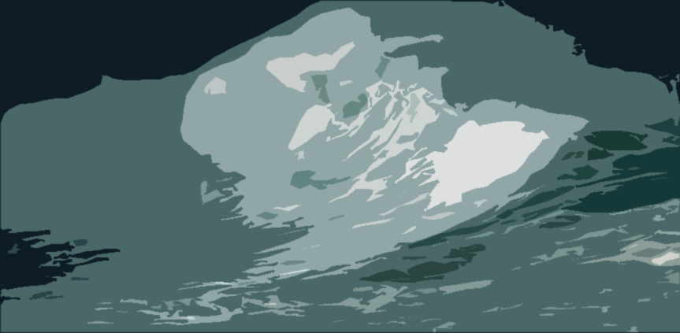
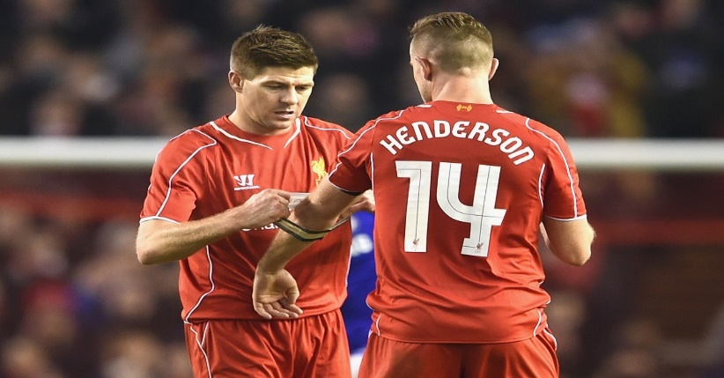
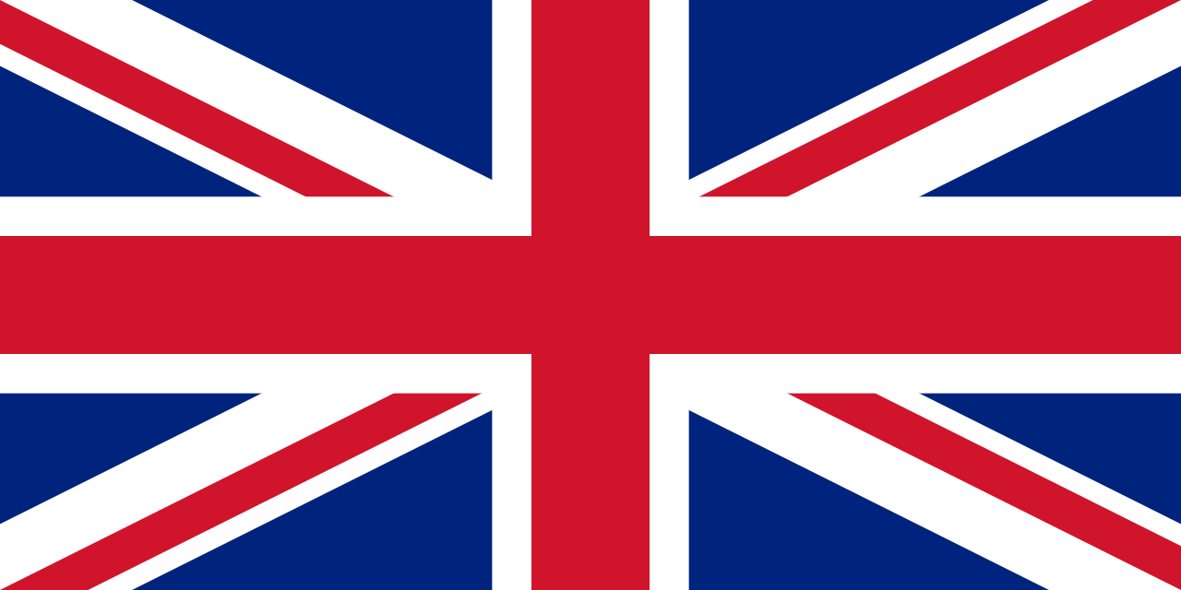
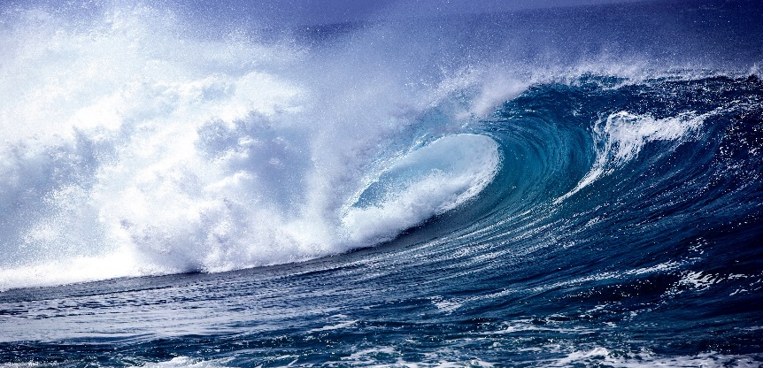
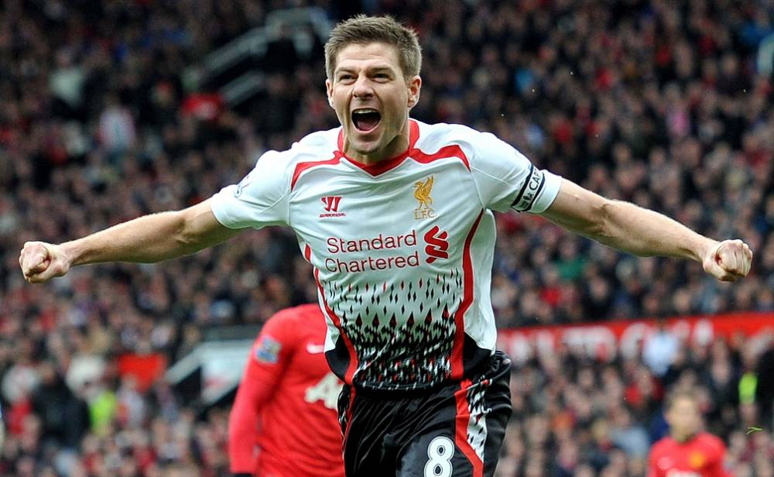
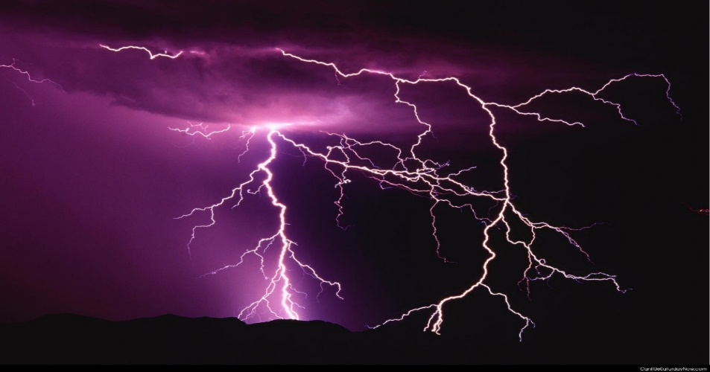
This blue lid of a plastic milk bottle will be the item to be used in the film when I show the audience what item I use to portray the colour blue.
When thinking about the colour blue, I think of trust. Steven Gerrard shows trust to Jordan Henderson by giving him the captain armband as Steven Gerrard is being substituted. Trust is a blue connation.
This is the Union Jack flag, I wanted to include it because the majority of the flag is blue and I am proud to say I am proud to be British.
Here is a picture of some waves crashing together, the inspiration I got when putting it on my mood board was the water element as water has a big blue connation.
When thinking about the colour purple/violent, I think of royalty. Steven Gerrard is a brilliant example as he has been his boyhood club Liverpool FC for 29 years. Royalty is a violet/purple connation.
When I think about what purple might sound like, I think about the loud rumbles of lighting striking. I may include it in my film to portray the colour purple/violet.

Slide 5
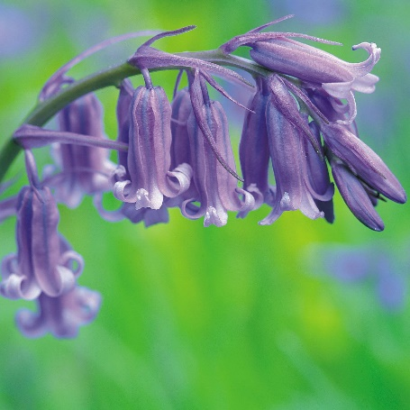
Here is a picture of some blue bells, the inspiration I got when taking it was the smells of purple/violet. The smells come from the blossoms.

