Slide 1
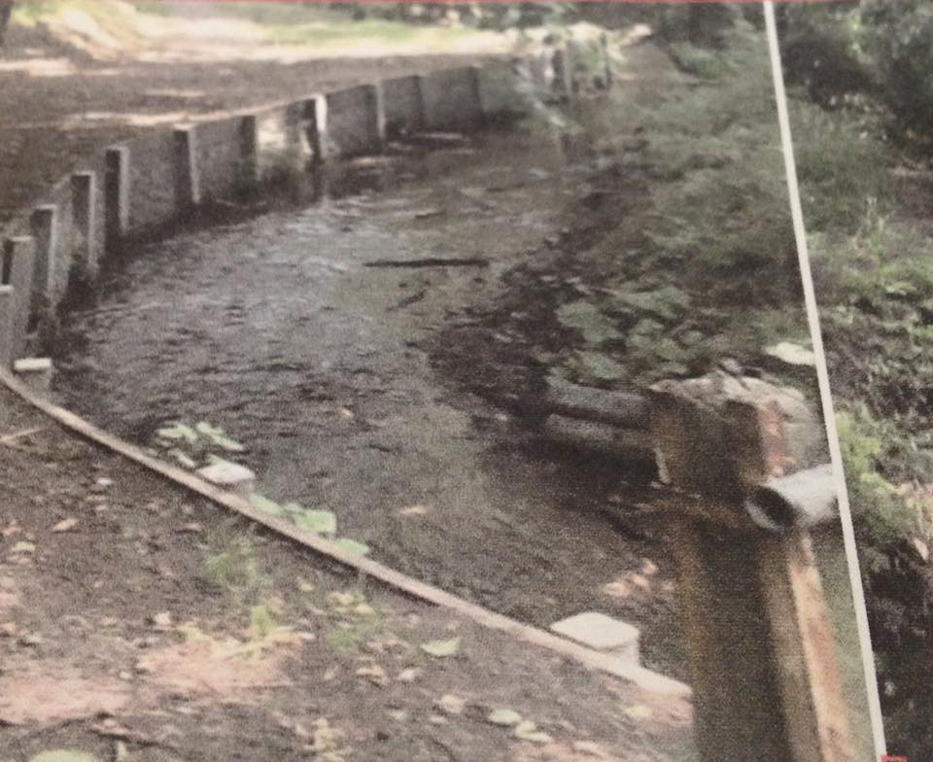
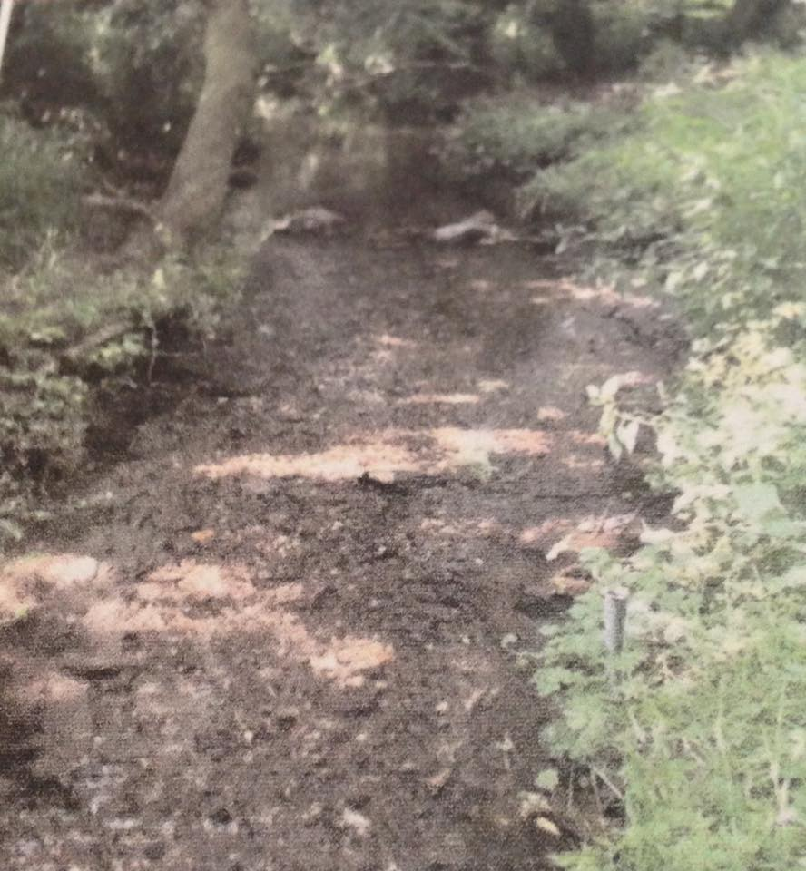
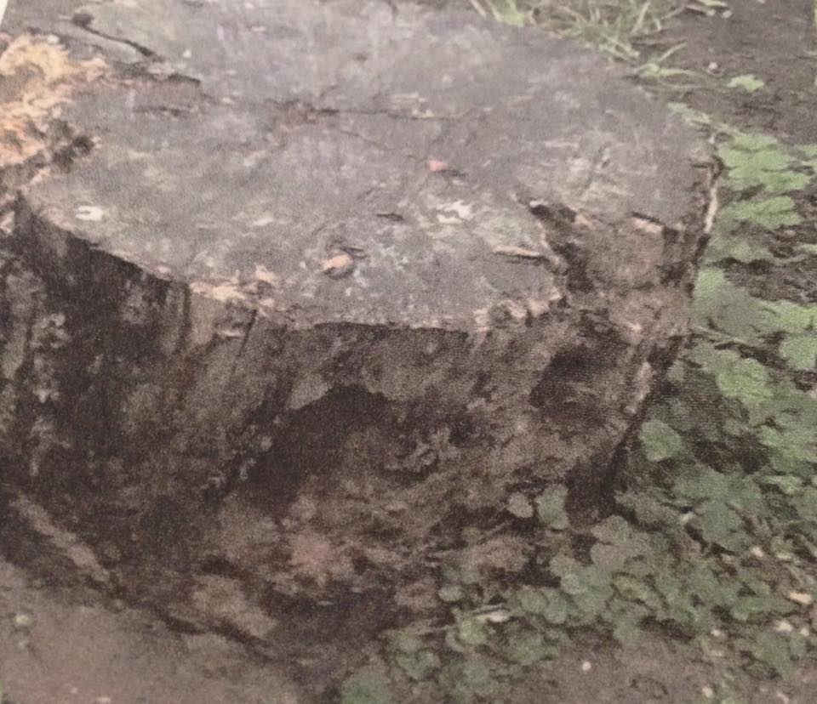
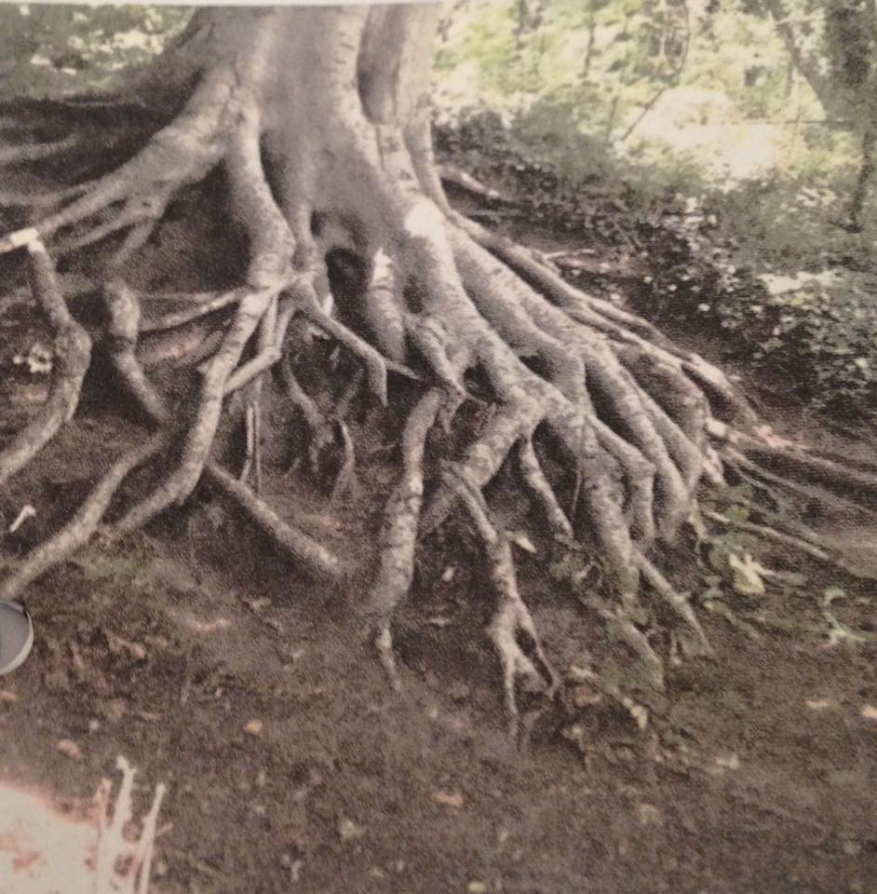
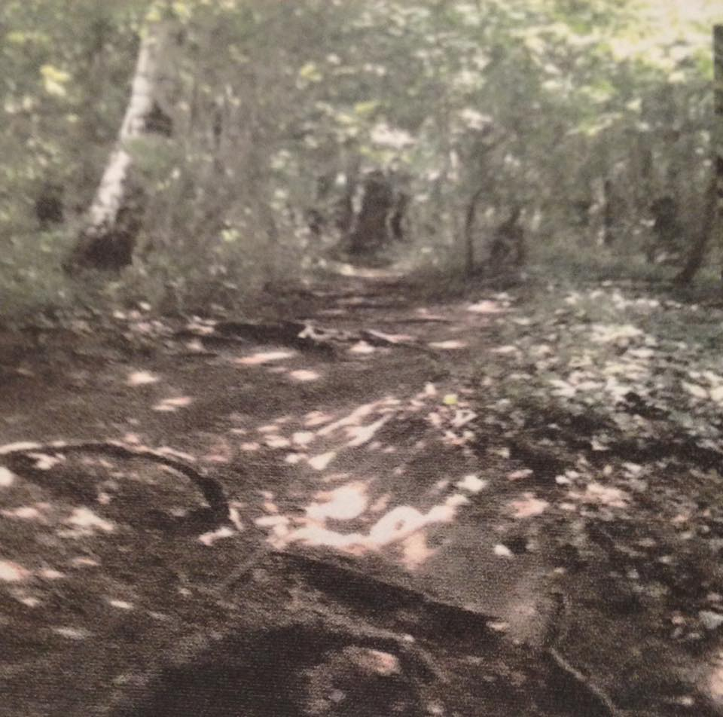
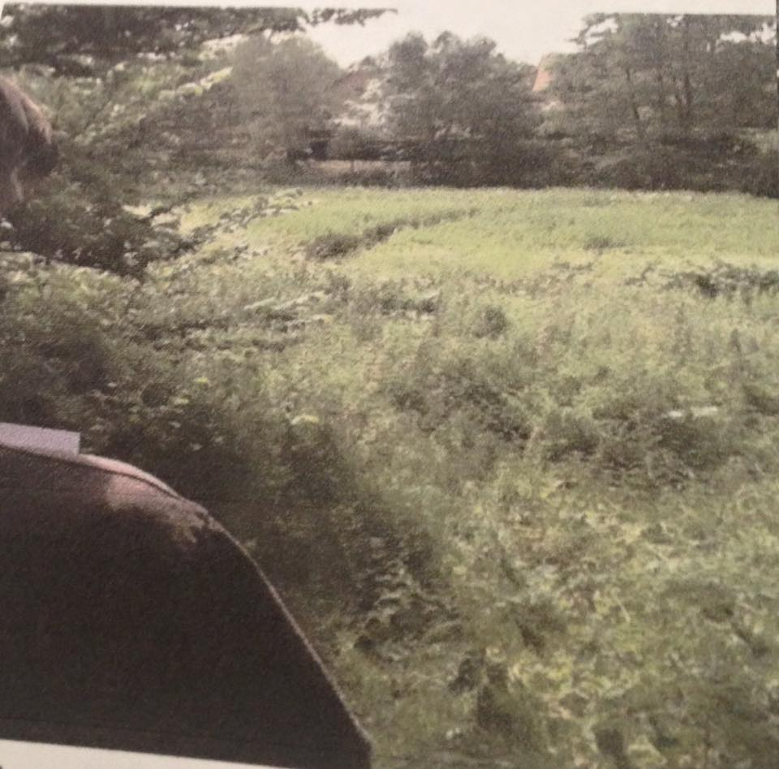
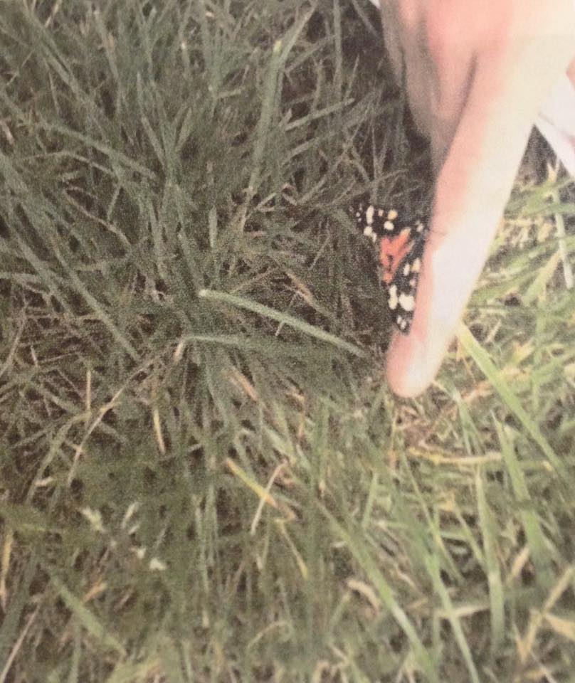
Mood Board For ‘Home Sweet Home’
Here is a shot of the stream again, but this time the stream was token at a different angle. This picture is going to be for the flashback images in the film. All to be faded in.
This weird looking stump of a tree was to show there is an unknown wilderness out there in Market Lavington. I had to take the picture because of the tree’s weird appearance. This picture is going to be for the flashback images in the film.
This stump in the woodland gave me inspiration of a possible location where the character may possibly sit down as he writes for his diary.
This stream in the woodland was to show the symbolism of ‘calmness’ of the village.
One of the many views in the village which tells the audience when you look down on the views they are amazing. It also feels as though you are viewing the location, from behind the character. This picture is going to be for the flashback images in the film.
The uphill part of the woodland gave me inspiration of a possible location where the character may possibly walk up the hill.
This picture just went out to prove that the wildlife around the village is amazing to see wherever you go. This picture is going to be for the flashback images in the film.
Alex Damon

Slide 2
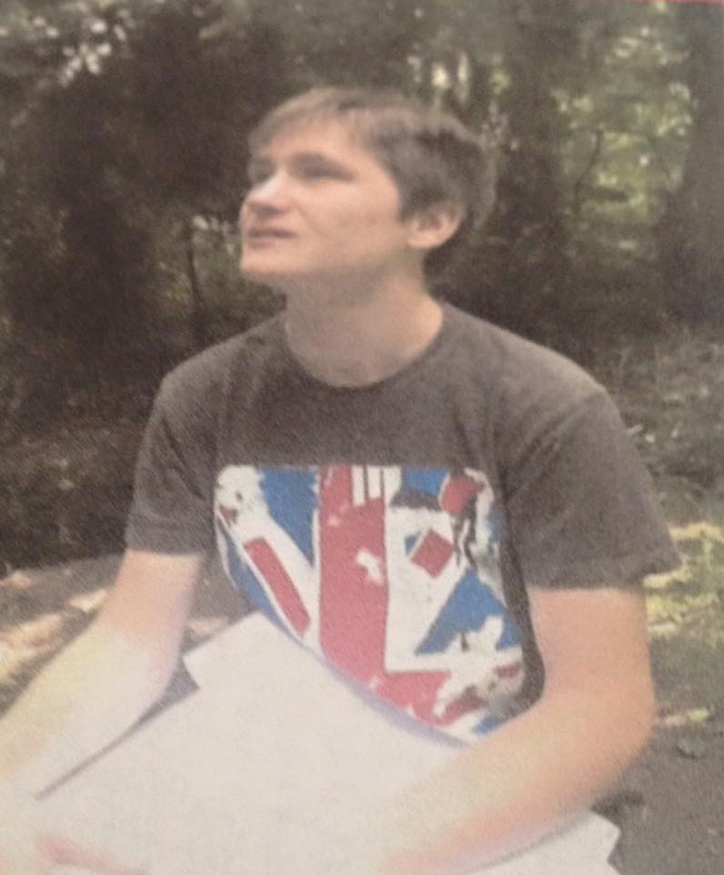
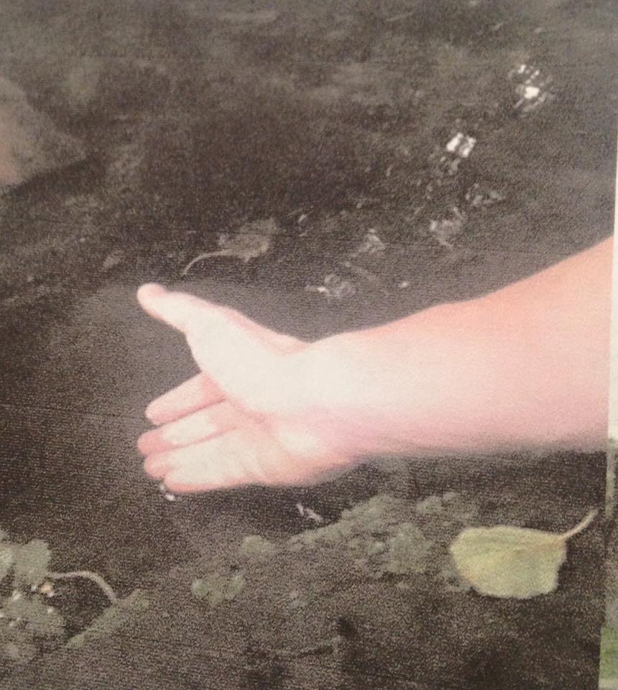
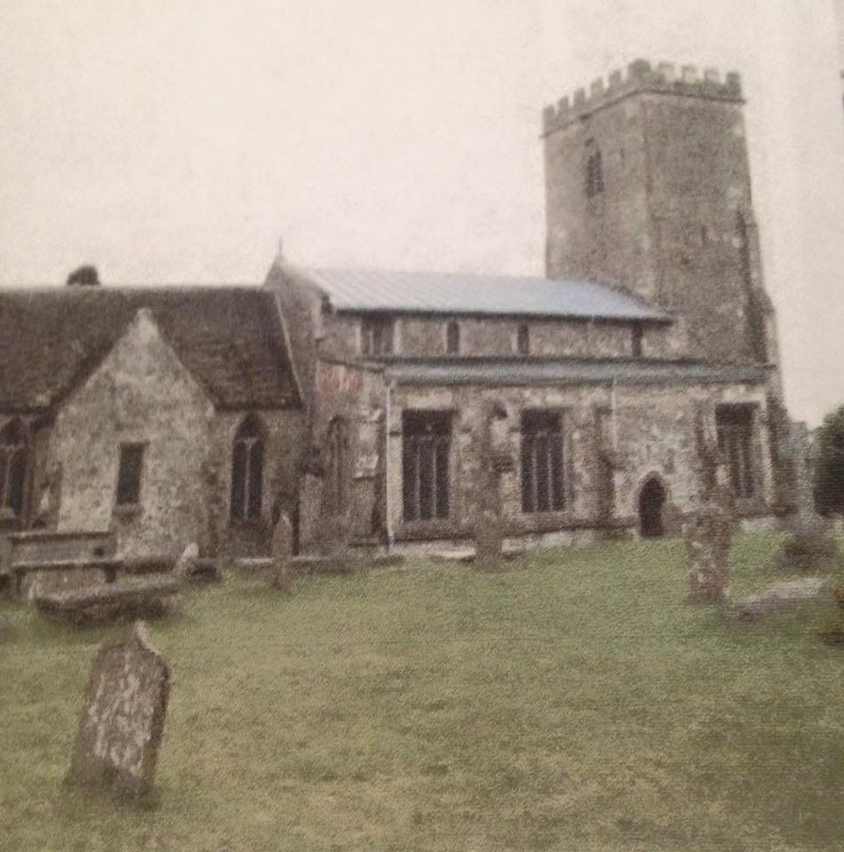
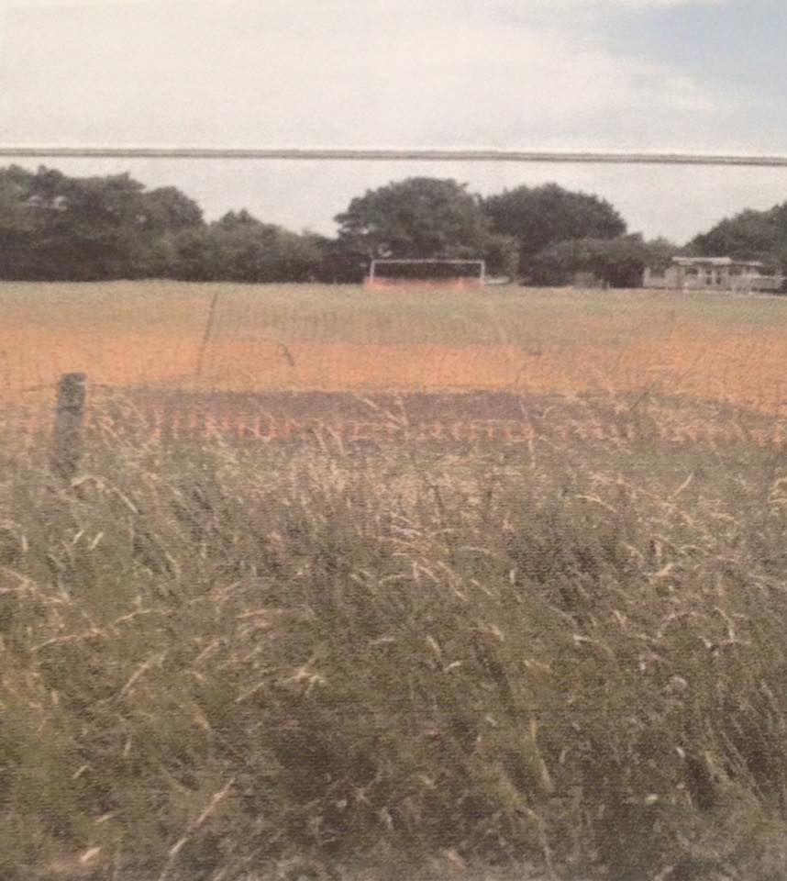
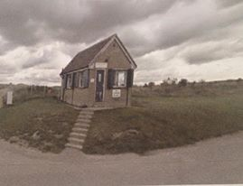
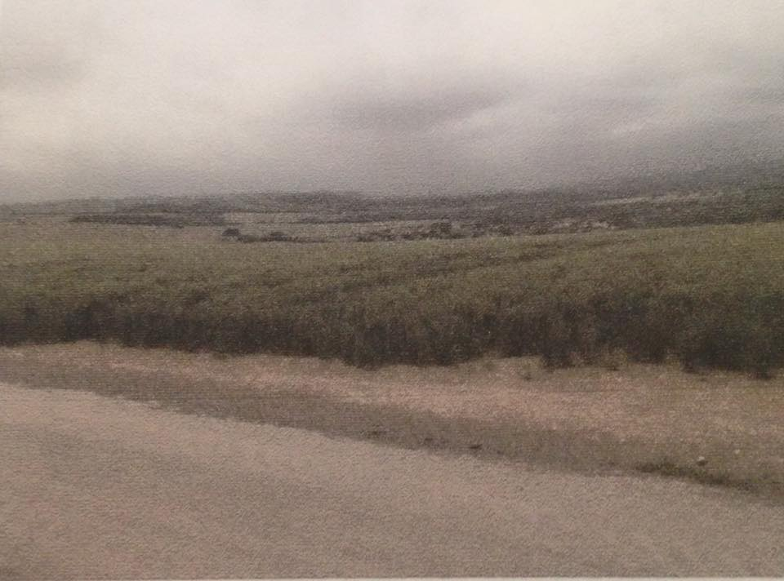
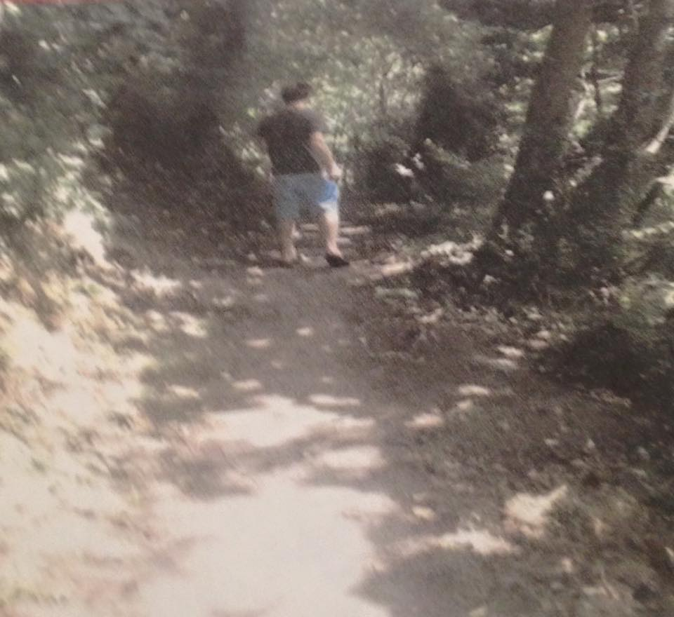
Alex Damon
With the woodland being a possible location I got intrigued to show the audience what it would be like if I did the writing in the diary scene in the woodland. I may change the location to Salisbury Plain.
This is St Marys Church, to show where I go each Sunday and also it is an insight of a place which makes me feel comfortable with no worries. This picture is going to be for the flashback images in the film.
Some of the most happiest memories in my life took place in this location. It is of Davies Field, the most popular and famous football pitch in the Lavington area.
The inspiration from this was to symbolism the character having a close connection to the elements of nature.
For the possible location choice of the woodland area, I got inspired to give the audiences a feel of what it would be like if I did the walking up the hill scene in the woodland. I may change the location to Salisbury Plain.
Here is showing another example of an amazing downwards view on Market Lavington but in a different location this time.
This is at the top of Lavington Hill for the most likely location to show where the character will be sat for the writing diary scene.

Slide 3
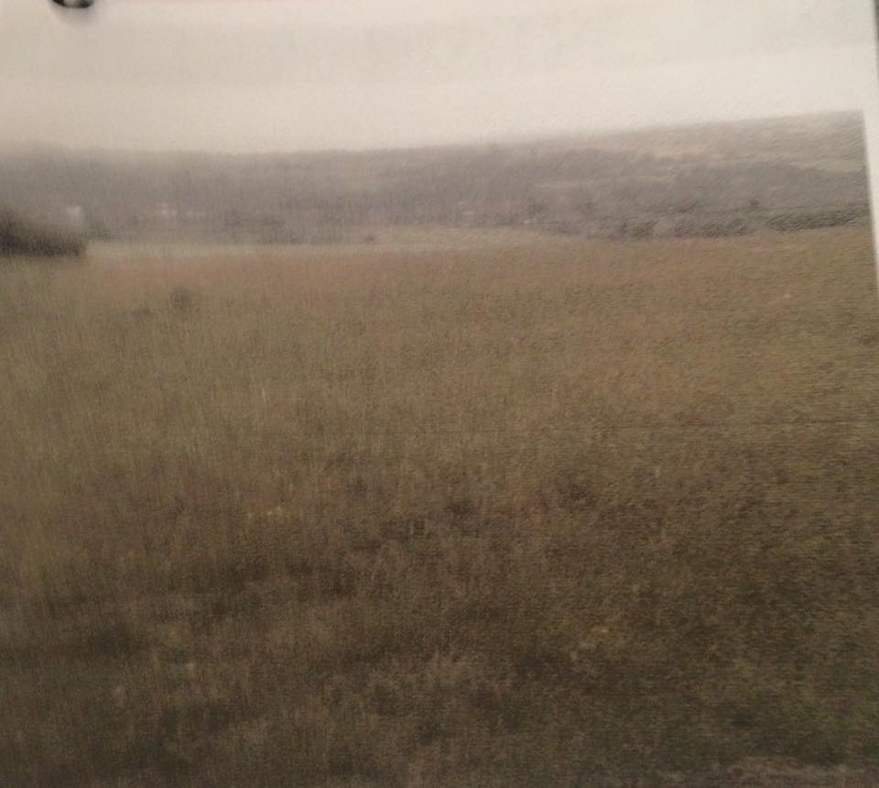
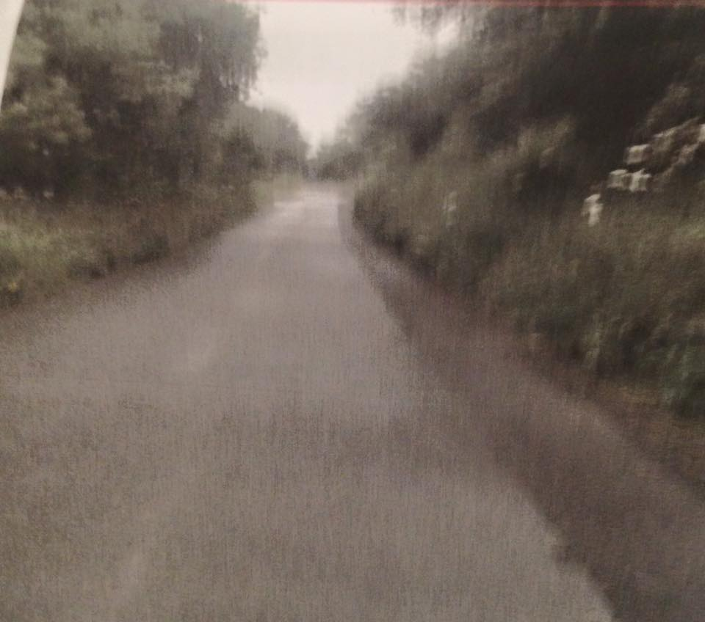
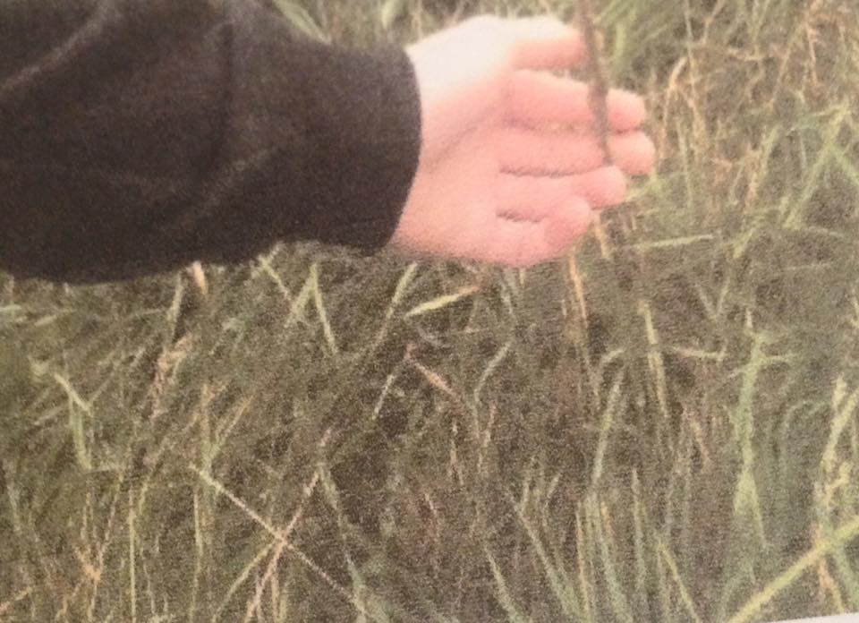
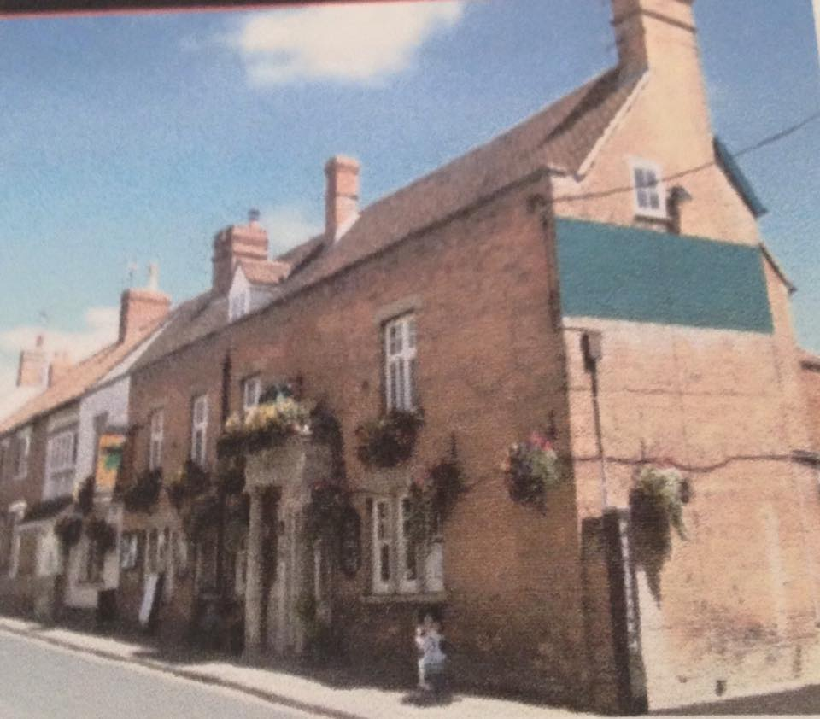
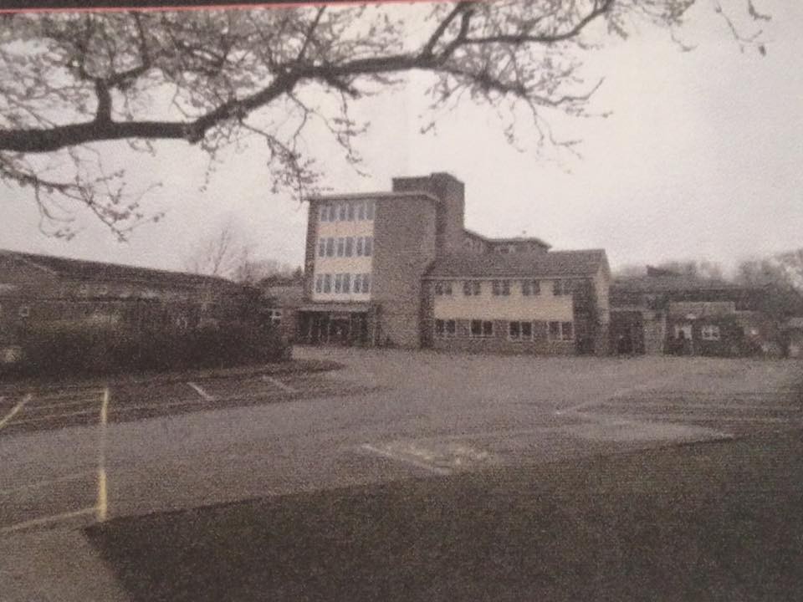
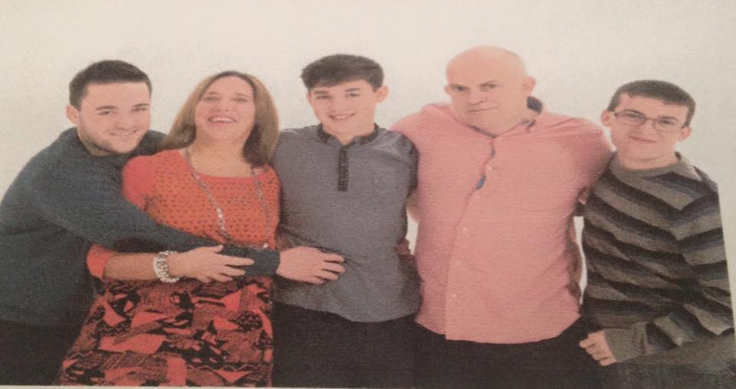
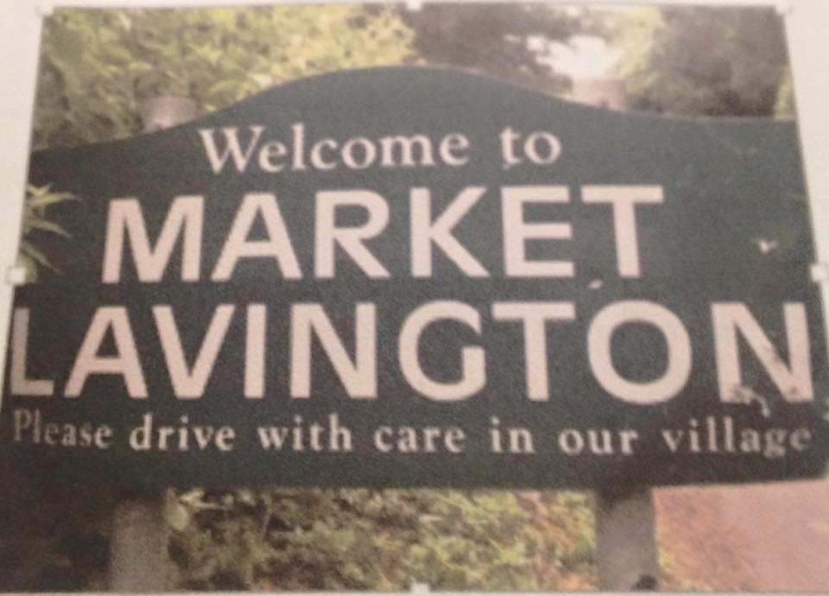
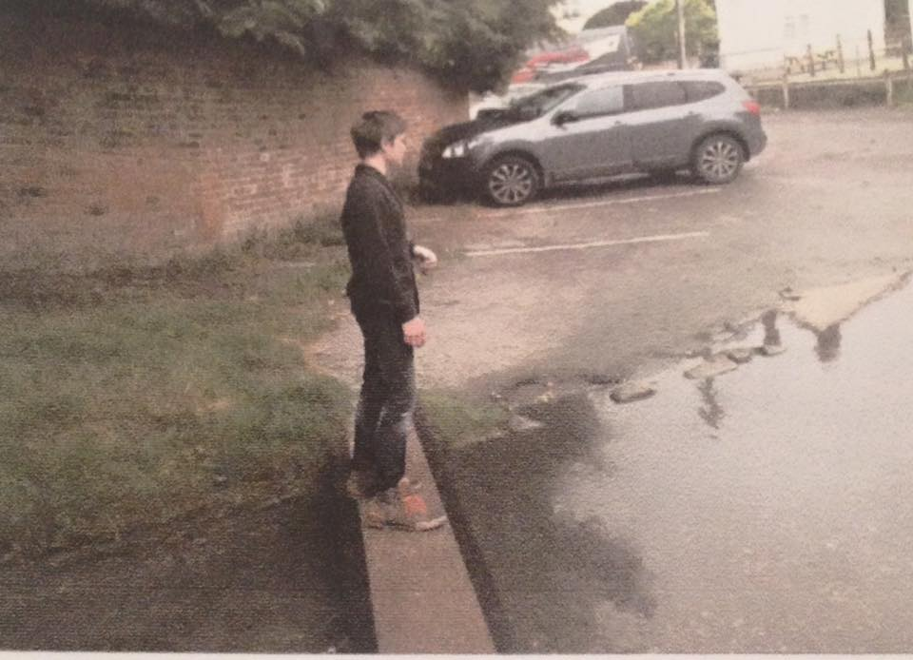
Alex Damon
Looking downwards again on Market Lavington as I take the picture from the top of Lavington Hill.
The inspiration from this was to symbolism the character having a close connection to the elements of nature.
Here is the local pub called the Green Dragon, I took it because I feel as though this place is my family’s second home and it shows the togetherness in the community.
The picture will show the audience the mostly likely location for the scene where the character walks up the hill to start the film.
This is a family picture and it gave me inspiration to show an example of what I would miss if I were leaving tomorrow. This picture is going to be for the flashback images in the film.
This is Lavington School, a place where there has been the best memories and it gave me inspiration to show an example of happy memories. This picture is going to be for the flashback images in the film.
I thought the sign when entering the village was a good introduction to the location. It will start the flashback images for the film.
Here is the character looking around Broadwell, this is a place to gather your thoughts in the village.

Slide 4
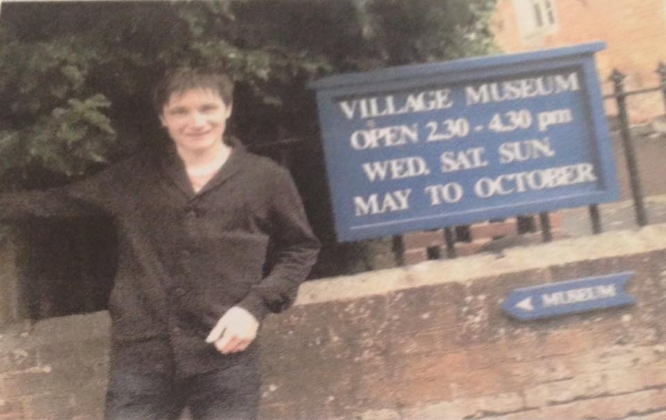
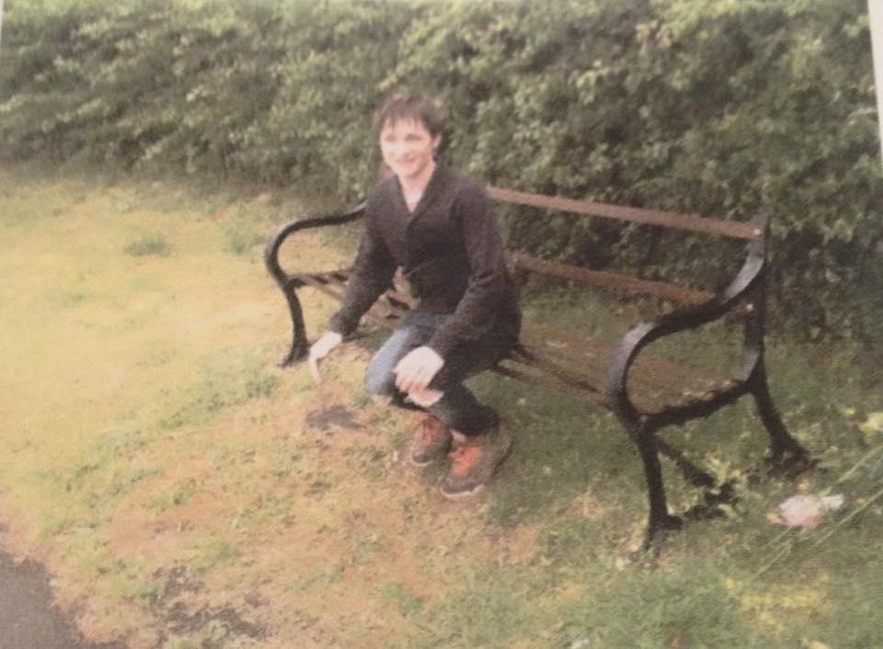
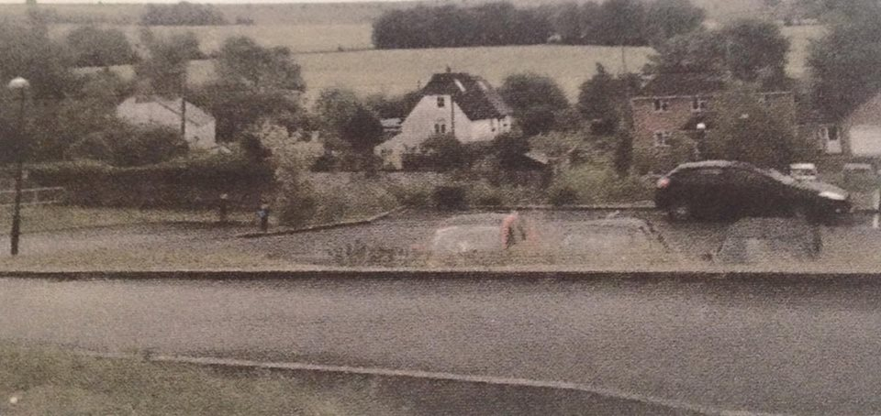
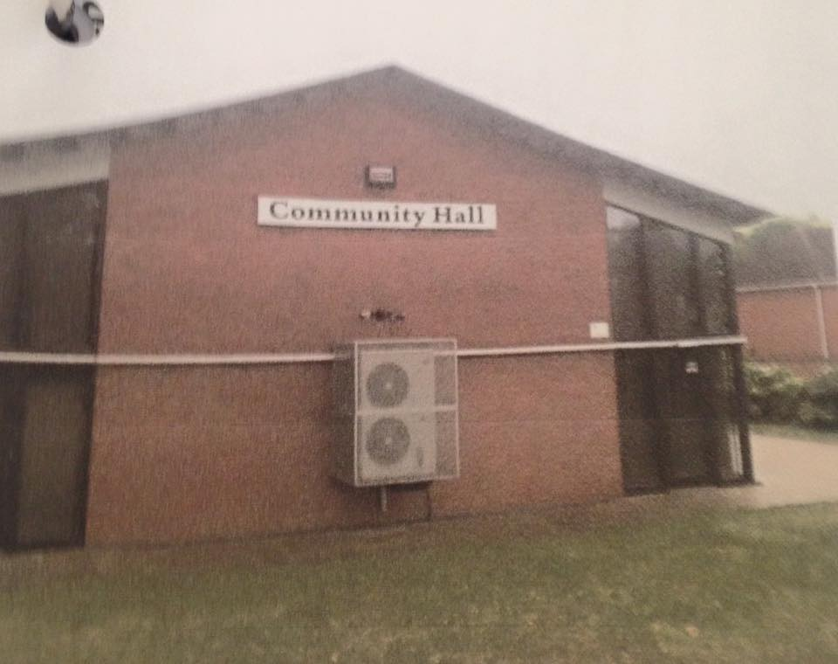
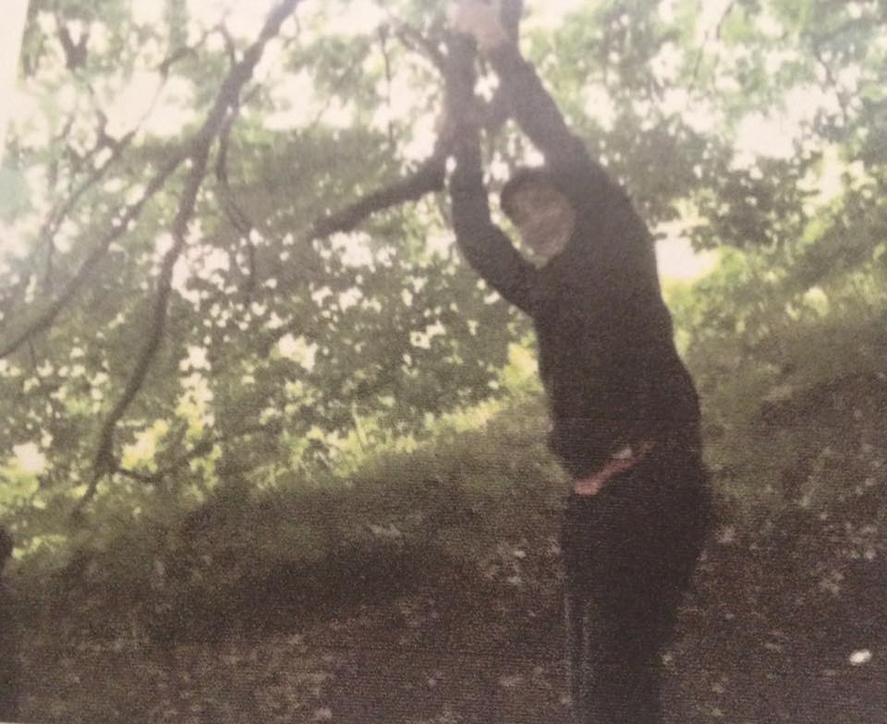
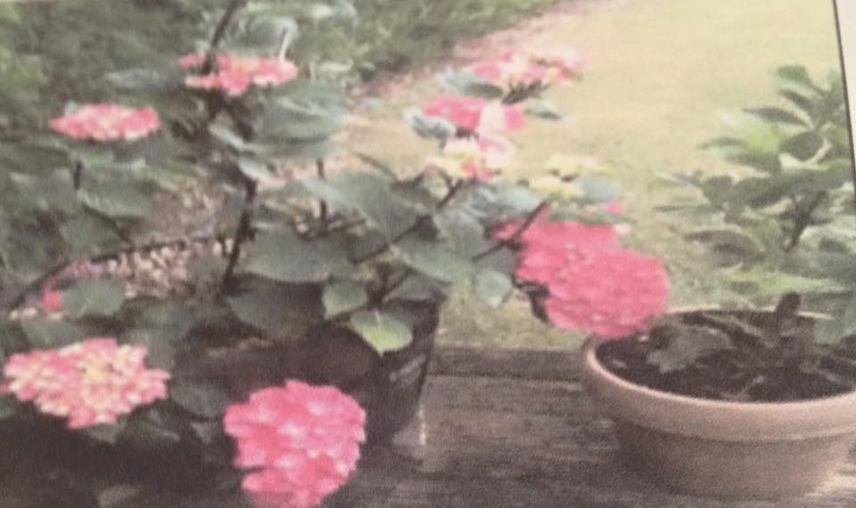
Alex Damon
Here is the character showing the way to the village ‘museum’, I took this picture because it is very interesting to look back at our history.
This is the character sitting on the most famous bench which has also been around the longest in the village.
When I saw this I had to take a picture of the fields which are behind the houses. This symbolisms a good place to live in.
Here is a picture of some pink flowers, the inspiration I got when taking it was the smells around the village. The smells come from the blossoms.
Here is the character is seen having a good time out on the swings in the woodland area, conveying the joyful atmosphere. This picture is going to be for the flashback images in the film.
This is the village’s community hall, I took it because this is location where all the locals come together.

